Slide 1
The Future Red Cross and Red Crescent
“Make the world we want”

Slide 3
THE FUTURE MOVES FASTER THAN EXPECTED.

Slide 4
WE ARE TRYING TO SOLVE 21ST CENTURY PROBLEMS
WITH 19TH CENTURY SOLUTIONS
Outdated systems of legislation, government and policy cannot match the speed of blockchain, the Internet of Things, AI, or the expanding web – as well as the social shifts the proceed or stem from these development.

Slide 5
ARE WE PREPARED?
ARE WE FIT TO SERVE THE NEEDS OF FUTURE CITIZENS AND COMMUNITIES?
WILL WE HAVE TO OFFER BE
WANTED AND NEEDED?

Slide 6
HOW DO WE CREATE VALUE AND LEAD IN THESE INCREASINGLY COMPLEX ENVIRONMENTS?

Slide 7
All planning, policy, and strategy processes use…
DATA / MODELING
But this only provides a limited view.

Slide 8
So, most perform additional…
CONSULTATIONS / RESEARCH
To provide additional perspectives.

Slide 9
Foresight widens the scope of analysis by looking for...
TRENDS

Slide 10
Foresight widens the scope of analysis by looking for...
TRENDS
EMERGING ISSUES
To gain insights and enhance our capacity
to anticipate and navigate change

Slide 11
We shape the world by the questions we ask.
-JOHN WHEELER
Notes:
Is this presentation not protected against modification?

Slide 12
So what is the storyline that gets us to a point where we understand not just the organisational impacts, but also the moral implications of
inaction.

Slide 13
SCENARIOS

Slide 14
Scenarios are stories about the future created to challenge our thinking and help us learn

Slide 15
Future scenarios are designed to surface tensions, espressing discomfort, not to enable the project described in the scenario to happen. The prototyping is a means to another destination, not necessarily its realization.

Slide 16
5 KEY CRITERIA:
DECISION MAKING UTILITY
DIFFERENT
They should not be so close to one another that they become simply variations of a base case.
It should contribute specific insights into the future that will allow decision makers to answer the overall question that is being asked.
PLAUSIBILITY
CONSISTENCY
CHALLENGE
They must fall within the limits of what might conceivably happen.
How we build the logic of each scenario must flow and not undermine the overall credibility of it.
The scenarios should challenge the organisation's conventional wisdom about the future.

Slide 17
2X2 MATRIX
CHOOSE TWO DRIVERS OF CHANGE

Slide 18
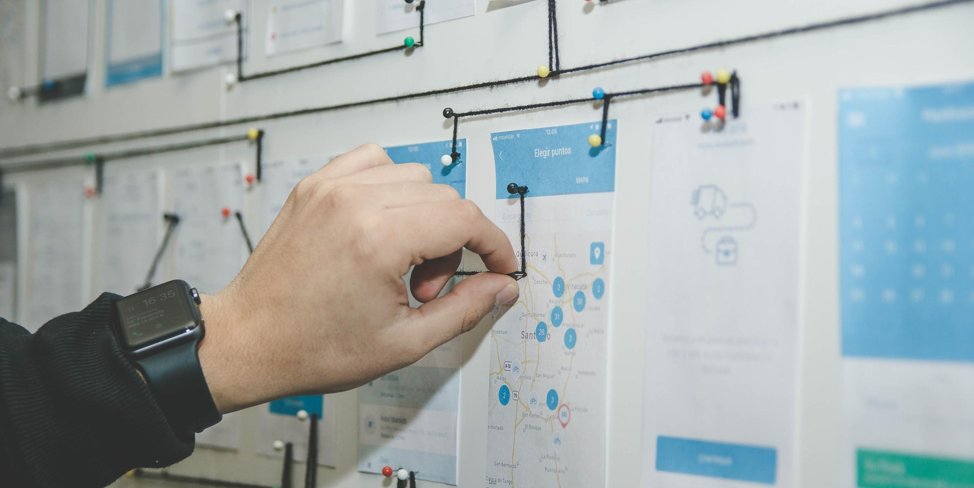
SCENARIO QUESTION:
Based on the drivers you have selected - what is the critical issue you are concerned about?

Slide 19
2X2 MATRIX
HIGH IMPORTANCE
CHOOSE TWO DRIVERS OF CHANGE
LOW IMPORTANCE

Slide 20
2X2 MATRIX
HIGH IMPORTANCE
HIGH UNCERTAINTY
CHOOSE TWO DRIVERS OF CHANGE
LOW UNCERTAINTY
LOW IMPORTANCE

Slide 21
2X2 MATRIX
HIGH
X
X
HIGH UNCERTAINTY
CHOOSE TWO DRIVERS OF CHANGE
LOW UNCERTAINTY
LOW

Slide 22
UNDERPINNING AND CONNECTING ISSUES IN YOUR SCENARIO
WAYS OF
EXPLAINING REALITY
Events Orientation tries to look for immediate cause and effect.
EVENTS
PATTERNS
TRENDS
STRUCTURES
MENTAL MODELS
Systems Thinking looks beneath the surface at the patterns, trends, structures, and systems in play.

Slide 23
STRUCTURE OF SCENARIO
A highly descriptive title: short enough to memorable; descriptive enough to be transmitting the essence of what is happening in the scenario.
Compelling 'story-lines': scenarios are narratives of how events might unfold between now and the selected time-horizon. It should tell a story that is remarkable, convincing, logical, and plausible.
Description of what has happened to each driver of change: Describe what has happened to the drivers of change you have chosen.

Slide 24
The future belongs to the curious – those who see beyond existing systems and thinking patterns.

Slide 25
VISION OF THE FUTURE

Slide 26
“In order to change an existing imagined order, we must first believe in an alternative imagined order”
Yuval Noah Harari, 2014

Slide 27
WHAT IS OUR
PREFERRED FUTURE?
WHAT IS MOST
IMPORTANT TO US?
VISIONING
WHAT VISION WILL LEAD US FORWARD?

Slide 28
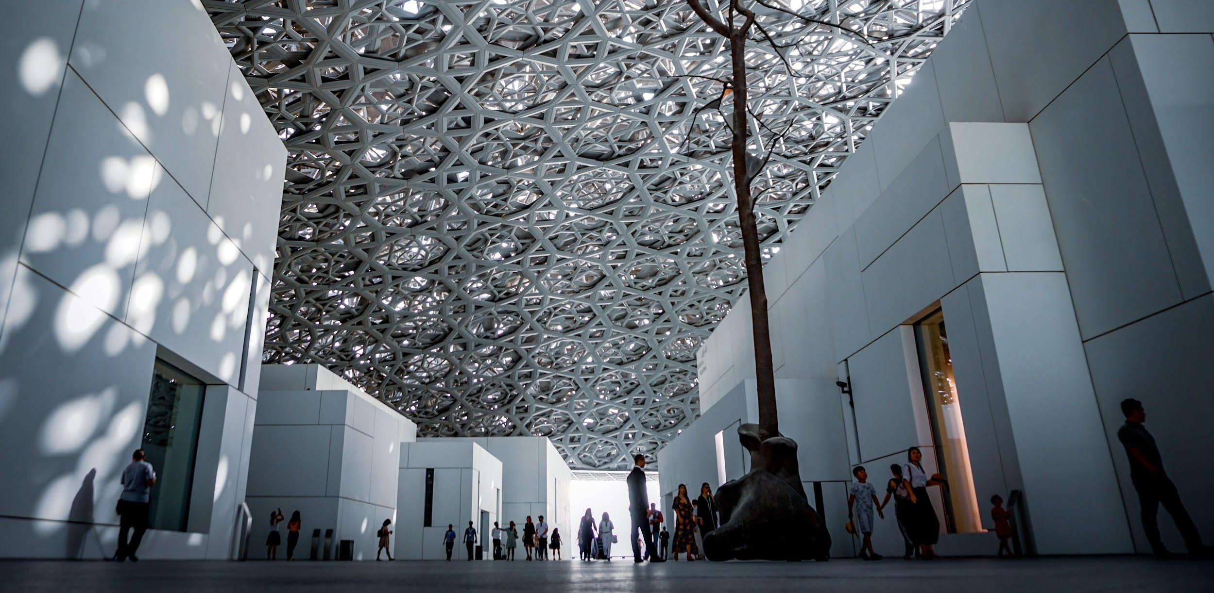
QUESTION:
SHOULD WE MAINTAIN A STRUCTURE THAT FITS THE LAST 10 YEARS OR SHOULD WE TRANSFORM INTO A STRUCTURE THAT WILL BE FIT FOR THE NEXT 10 YEARS?

Slide 30
S2030 Futures is about giving everyone the ability to create, act upon, and be part of the emerging future – so that no one is left behind.

Slide 31
MAY YOU LIVE IN INTERESTING TIMES...

